Slide 1
Societal transformations in models for energy and climate policy: the ambitious next step
Evelina Trutnevyte, Léon F. Hirt, Nico Bauer, Aleh Cherp, Adam Hawkes,
Oreane Y. Edelenbosch, Simona Pedde, and Detlef P. van Vuuren
One Earth 2019, 1(4), p. 423-433, DOI: 10.1016/j.oneear.2019.12.002

Slide 2
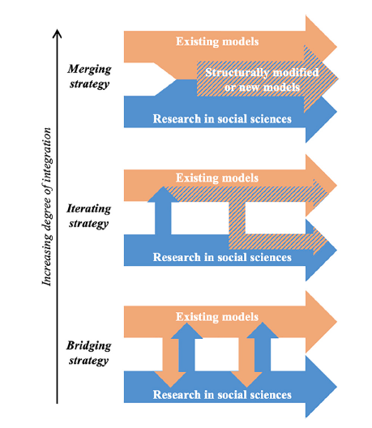
Three strategies of collaboration between modelers and social science researchers
structurally modified or new models
story-and-simulation approach
(rather common)
staying in own realm with some brief interactions
Source: Hirt et al. (2020) Environmental Innovation and Societal Transitions; Trutnevyte et al. (2019) One Earth

Slide 3
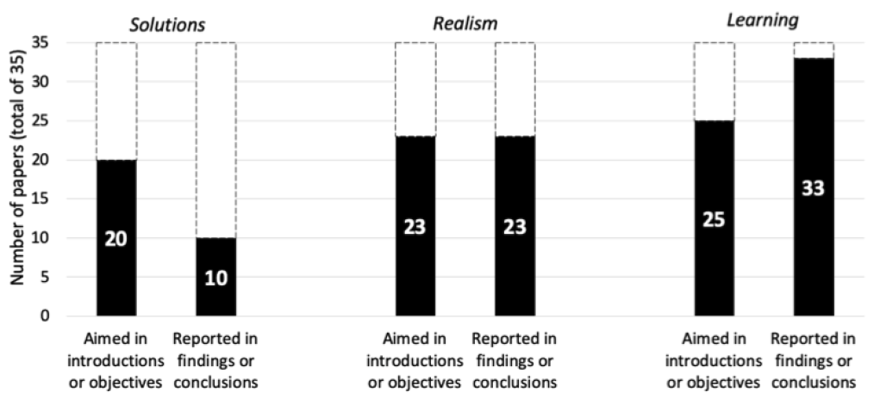
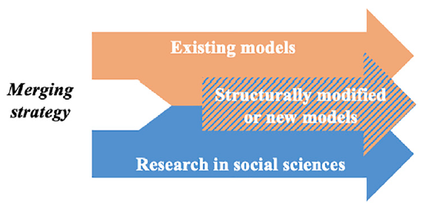
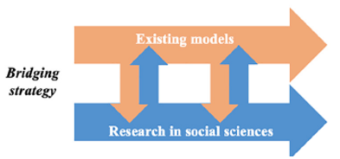
Expected vs. delivered outputs
Insights from
44 peer-reviewed papers from a systematic review
rather rare
more common
Source: Hirt et al. (2020) Environmental Innovation and Societal Transitions

Slide 4
Future perspective
We need more focus on the merging strategy, following these steps:
Map assumptions in existing models
Conduct empirical research on quantifiable generalizable patterns
Modify or build new models

