Slide 1

Global scenarios of residential heating and cooling energy demand and CO2 emissions
Alessio Mastrucci, Bas van Ruijven, Edward Byers, Miguel Poblete‑Cazenave, Shonali Pachauri
International Institute for Applied Systems Analysis (IIASA)
Climatic Change (2021) 168:14
https://doi.org/10.1007/s10584-021-03229-3

Slide 2
Introduction
Motivations:
Buildings account for 36% of global final energy demand and are key to mitigating climate change.
Most global scenario studies lack granularity and overlook heterogeneity in the building sector, limiting the evaluation of demand transformations.
Objectives:
Develop global residential building scenarios for the shared socioeconomic pathways (SSPs) 1–3.
Assess the evolution of building stock, energy demand, and CO2 emissions for space heating and cooling with the bottom-up model MESSAGEix-Buildings.

Slide 3
Methods: MESSAGEix-Buildings model
Bottom-up global framework with improved granularity and building dynamics
Soft-linked to an integrated assessment model (IAM)
Projections
Building types,
slums, floorspace, …
Variable Degree Days
calculated over a spatial grid
Ref: Mastrucci et al., 2019
Scenario runs
Discrete choice models
Household decisions on renovation, new construction, and fuel switches based on life-cycle costs (investment, operation, intangible)
Material Flow Analysis
New constructions
and demolitions
Ref: Sartori et al., 2016

Slide 4
Residential energy demand for heating and cooling
Final energy for space heating is dominated by the global North and decreases as a results of progressive energy efficiency improvements, especially in SSP1.
Energy for space cooling will double in SSP3 and triple in SSP1 by 2050, driven by population growth, air-conditioning uptake and larger housing size in the global South.

Slide 5
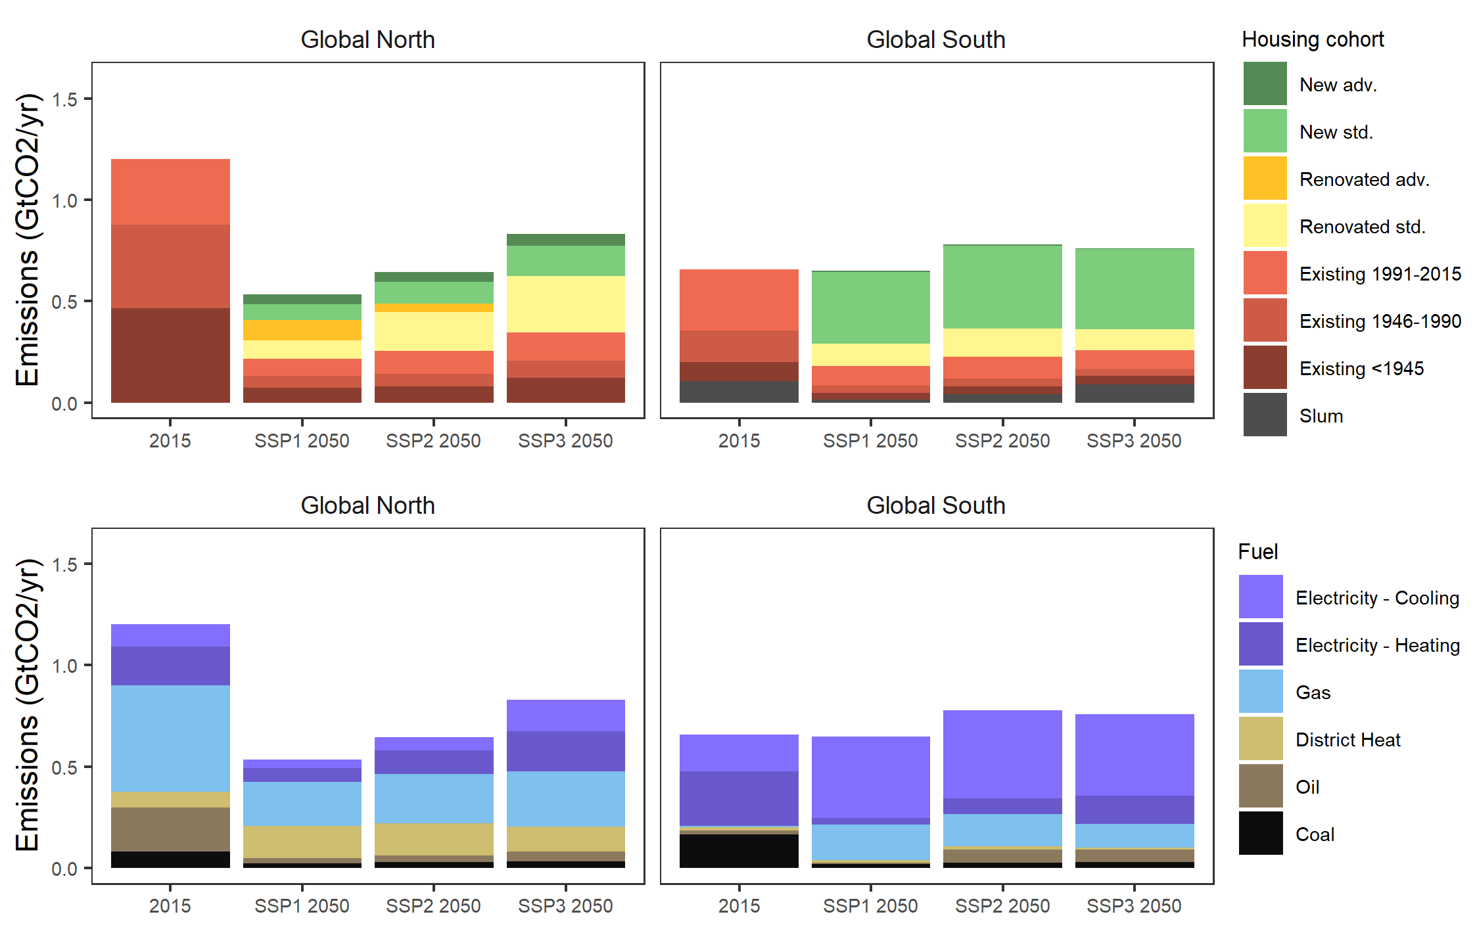
Residential CO2 emissions for heating and cooling
CO2 emissions for space heating will decrease globally between 34.4 (SSP3) and 52.5% (SSP1) by 2050 under energy efficiency improvements and electrification.
CO2 emissions for space cooling will increase globally by 58.2 (SSP1) to 85.2% (SSP3) by 2050, due to the stark rise of cooling demand in developing countries, especially from mid- and high-income households.
This study can support further analysis of buildings mitigation strategies and joint assessment with other sectors in IAMs, to inform policies towards reaching global climate and sustainable development targets.

