Slide 1
Climate change impacts on renewable energy supply
Gernaat, D.E.H.J., de Boer, H.S., Daioglou, V. et al. Climate change impacts on renewable energy supply. Nat. Clim. Chang. 11, 119–125 (2021). https://doi.org/10.1038/s41558-020-00949-9

Slide 2
Introduction
Renewable energy resources, which depend on climate, may be susceptible to future climate change
Here we use climate and integrated assessment models to estimate this effect on key renewables.
Future potential and costs are quantified across two warming scenarios for eight technologies:
utility-scale and rooftop photovoltaic,
concentrated solar power,
onshore wind energy,
offshore wind energy,
first-generation bioenergy,
lignocellulosic bioenergy,
and hydropower.
The generated cost–supply curves are then used to estimate energy system impacts.

Slide 3
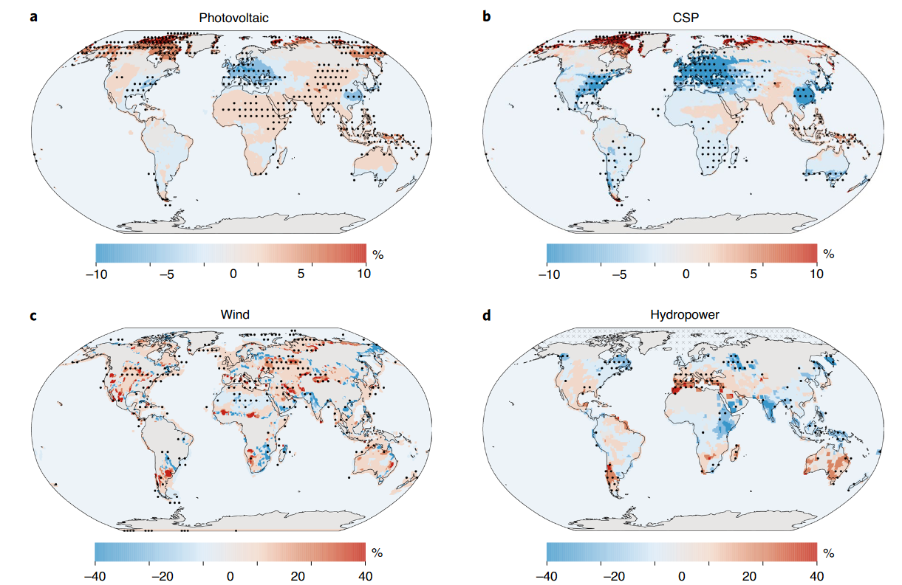
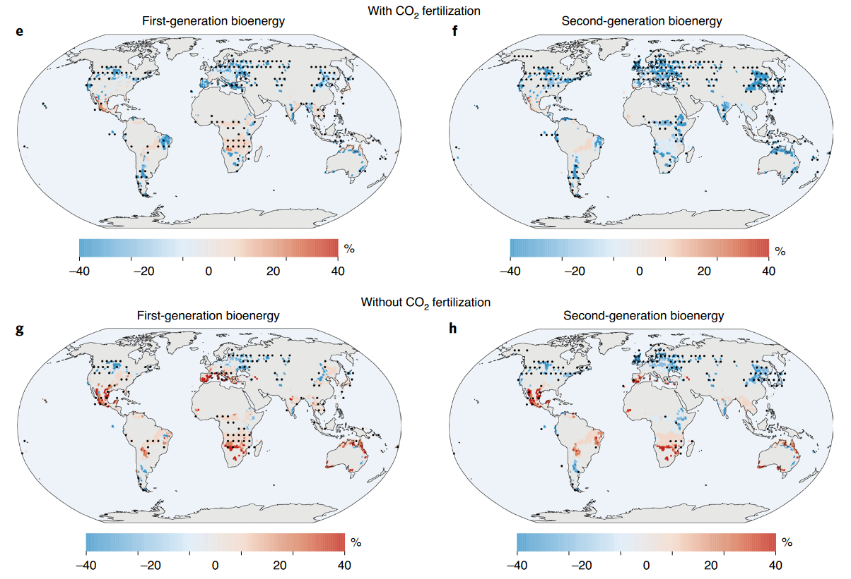
Impact potential: historical vs RCP60 in 2070-2100

Slide 4
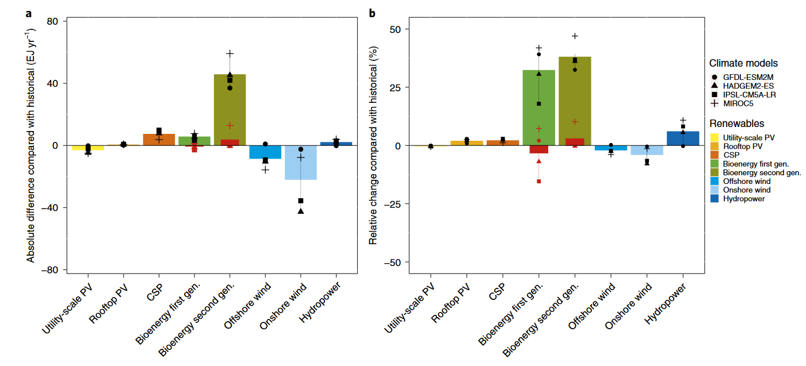
Impact potential: historical vs RCP60 in 2070-2100

Slide 5
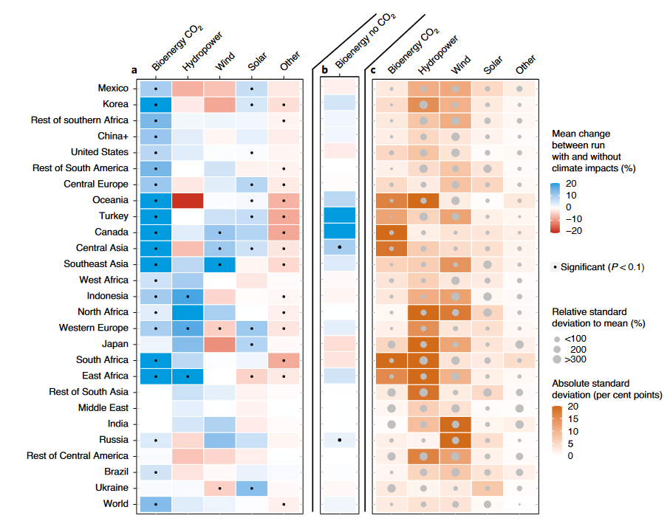
Climate impacts renewables RCP 6.0
Observations:
Overall, 4-7% more renewables
Bio-energy
Mostly ++
Significant
Wind
+ and -
Uncertainty
Hydropower
+ and – (few ++)
Uncertainty
Solar
Minor
More significant (temperature)
Fossil-fuel & Nuclear declines
1% to 2% CO₂

Slide 6
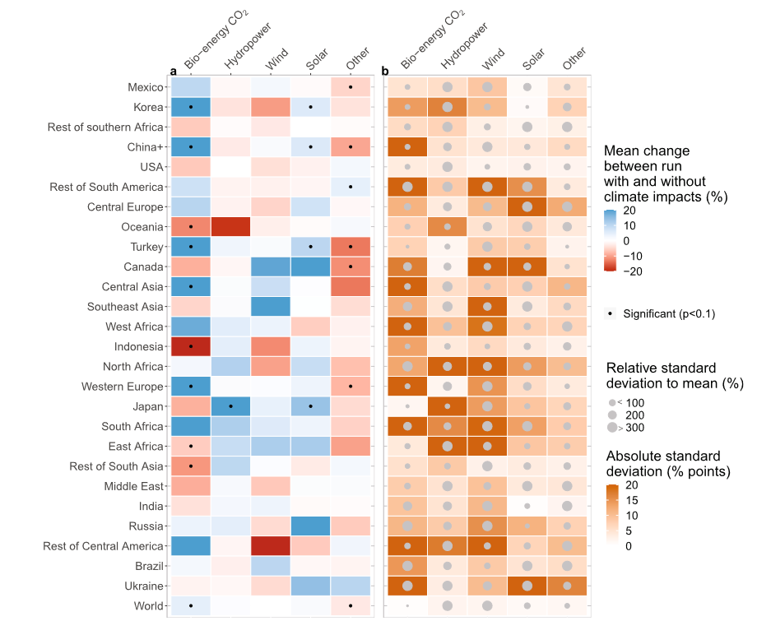
Climate impacts renewables RCP 2.6
Observations:
Surprisingly similar size effect compared to RCP 6.0
More renewables, more susceptible to small changes
Less prevalent bio-energy effect
More impacts on wind and hydropower → more uncertainty
Indirect effect most among renewables
Risk: similar to historical
Smaller climate change signal
Could the GCM’s

Slide 7
Conclusions
In a baseline: no serious global negative impacts, possibly some positive
Results can differ for specific regions
Most notable: bio-energy
CO2-fertilization, although still uncertain
Hydropower and wind show mixed results
Mostly moderate
But some regions gaining and others declining
High uncertainty
Impacts on solar are minor
In a future mitigation scenario, these impacts are smaller, but the energy system response is similar to that in the baseline scenario given a larger reliance of the mitigation scenario on renewables.

