Slide 1
Global socio-economic and climate change mitigation scenarios through the lens of structural change
Lefèvre, J., Le Gallic, T., Fragkos, P., Mercure, J.-F., Simsek, Y., Paroussos, L., 2022. Global socio-economic and climate change mitigation scenarios through the lens of structural change. Glob. Environ. Change 74, 102510.

Slide 2
Research questions
Structural change refers to changes in various aspects of the economy including sector composition of output and employment, consumption and trade patterns.
a key driver of energy use and emissions
reflects distributional impacts and transition costs in mitigation pathways
--> A key element of global socio-economic and mitigation scenarios
The paper adresses the following questions:
What are the key conceptual considerations for assessing global scenarios through the lens of structural change?
What are the primary structural change effects to be expected in a trend baseline scenario and a ‘standard’ mitigation scenario?

Slide 3
Methods
Multi-sectoral macroeconomic IAMs (MS-IAMs): frameworks to explore structural change effects in global scenarios – embody key supply-side and demand-side drivers and variables of structural change
Model inter-comparison study with three MS-IAMs: E3ME-FTT, GEM-E3-FIT and IMACLIM-R
Two scenarios to 2050 run by the three models:
A ‘middle-of-the-road’ baseline scenario (harmonized SSP2 assumptions across models except structural change drivers)
A 2°C compatible scenario (~900 Gt FF CO2 budget) based on market-driven carbon prices (and sector specific incentives and regulations)

Slide 4
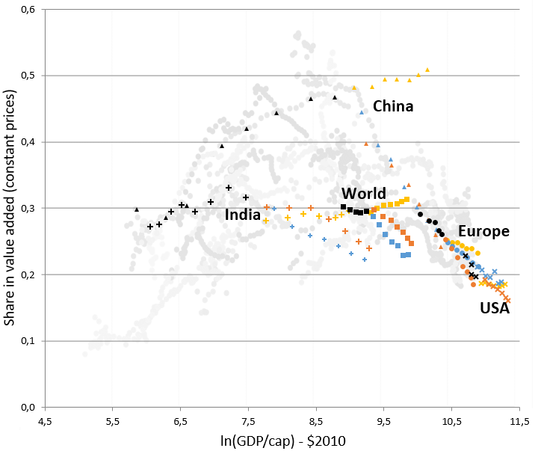
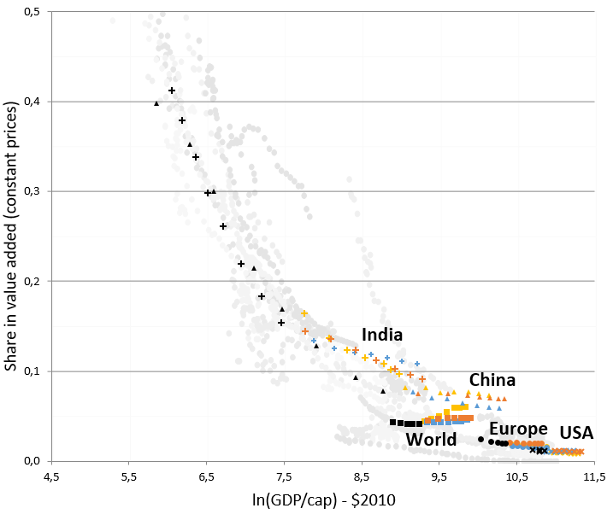
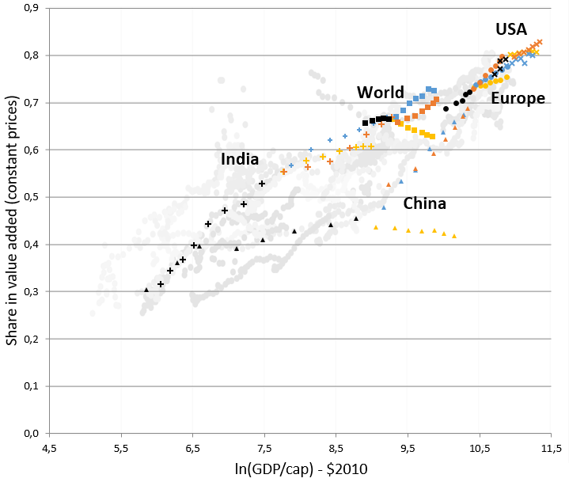
Key results 1: baseline scenario
Uncertain future economic pathways
of emerging economies
a) Agriculture
a) Services
a) Manufacturing

Slide 5
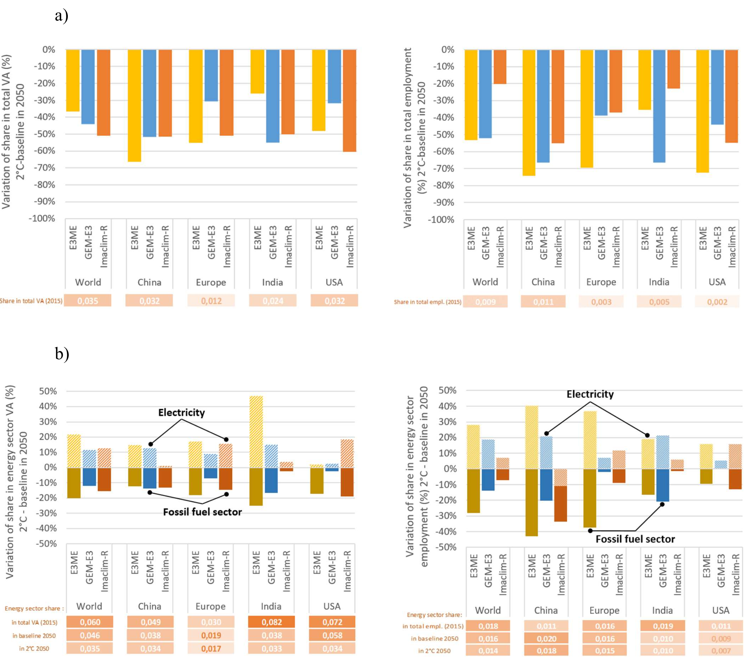
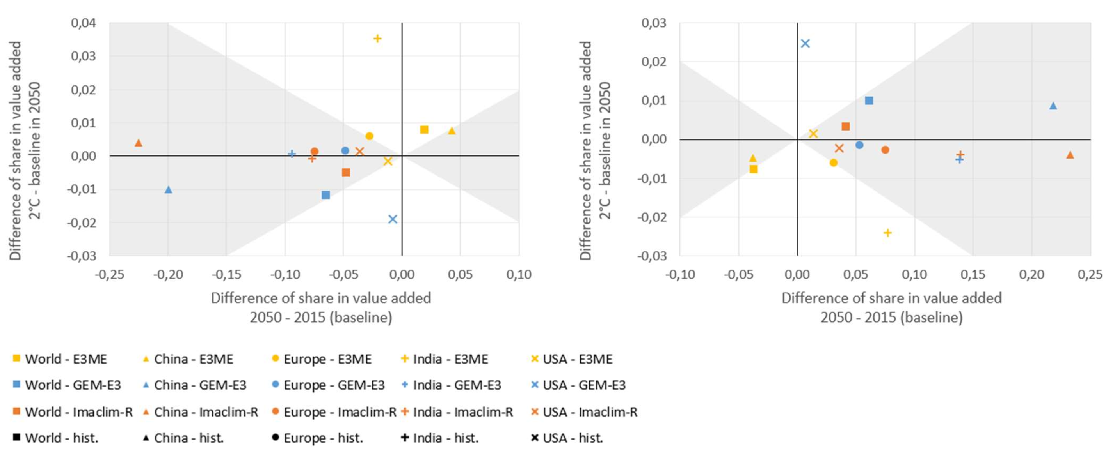
Key results 2: mitigation
But more radical changes for individual industries, e.g. fossil fuel vs clean electricity sectors
Second-order impact of climate policy on the macroeconomic structure (agriculture, manufacturing and services) compared to baseline changes
Fossil fuel sector (value-added and employment)
Fossil fuel vs electricity (value-added and employment)

