Slide 1
Influence of climate change impacts and mitigation costs on inequality between countries
Taconet, Méjean and Guivarch
2020 Climatic Change 160, 15–34
https://doi.org/10.1007/s10584-019-02637-w

Slide 2
RESEARCH QUESTIONS
Taconet, Méjean and Guivarch. 2020. Influence of climate change impacts and mitigation costs on inequality between countries. Climatic Change 160, 15–34.
https://doi.org/10.1007/s10584-019-02637-w
How will climate change affect future inequality between countries?
Lower inequality in low-emission scenarios?
How much convergence between countries will continue and how fast (demographic, socio-economic, education, institutions, technical progress assumptions)?
How large will the impacts of climate change be, and how unevenly distributed between countries?
How large will the costs of climate change mitigation be, and how unevenly distributed across countries?

Slide 3
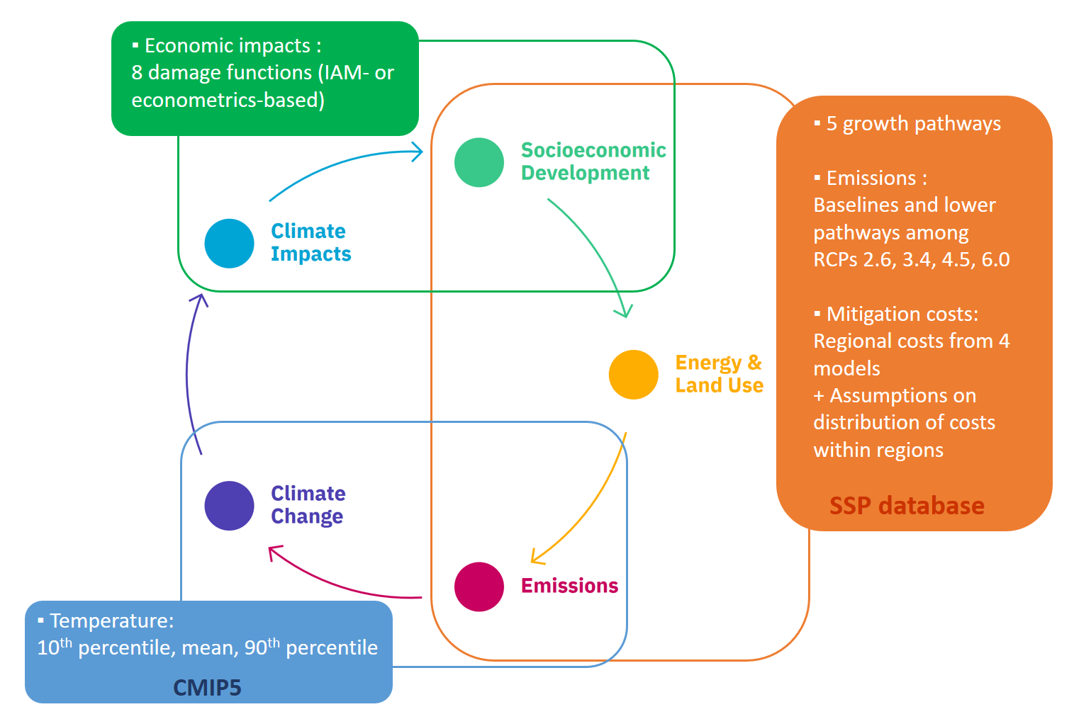
METHODS
Taconet, Méjean and Guivarch. 2020. Influence of climate change impacts and mitigation costs on inequality between countries. Climatic Change 160, 15–34.
https://doi.org/10.1007/s10584-019-02637-w
3408 scenarios, projections of GDP and GDP per capita for 161 countries, up to 2100.
Gini coefficient of inequality between countries (population-weighted international inequality).

Slide 4
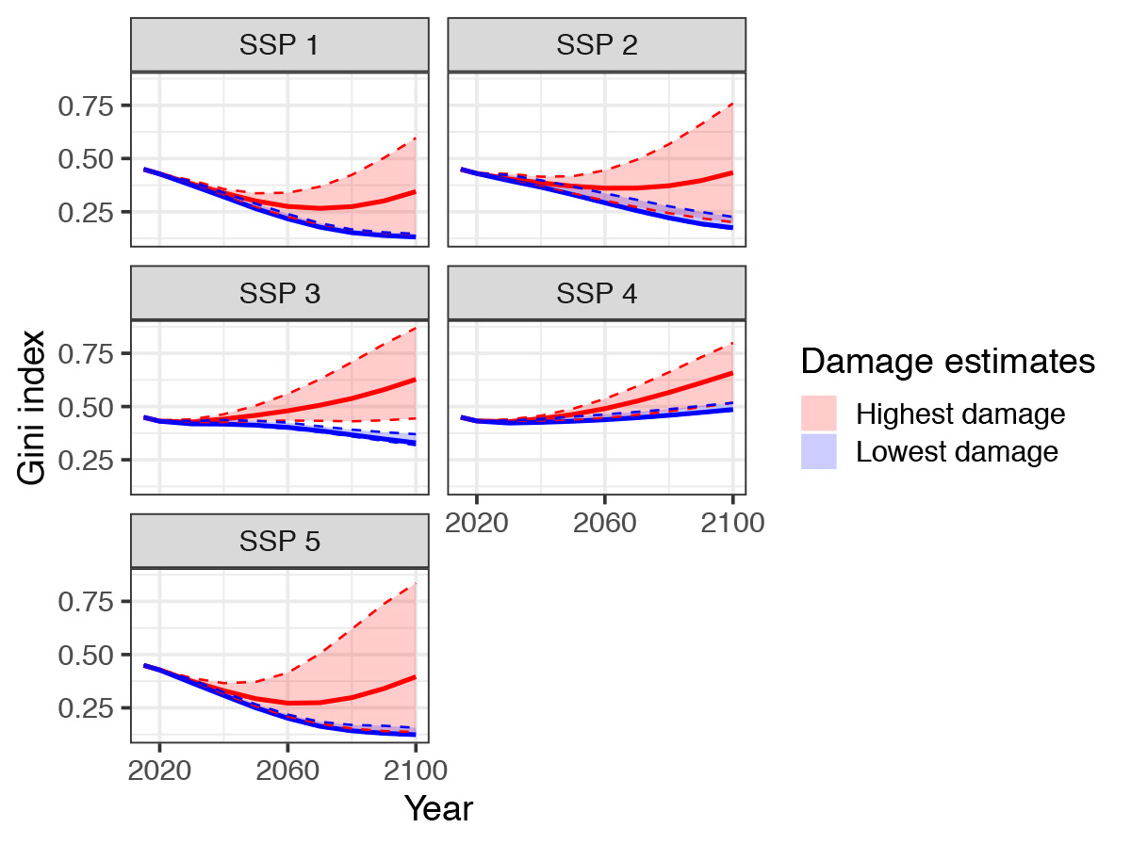
RESULTS
Taconet, Méjean and Guivarch. 2020. Influence of climate change impacts and mitigation costs on inequality between countries. Climatic Change 160, 15–34.
https://doi.org/10.1007/s10584-019-02637-w
Impacts of climate change will slow the expected convergence between richest and poorest countries in the 21st century.
Under the highest damage estimates suggest warming would reverse gains in declining inequality over the past few decades.
Emission pathways compatible with the 2°C target from the Paris Agreement would limit the increase in inequality, and display the lowest inequality levels.
Climate change mitigation is key to limiting future inequality, provided that mitigation costs do not fall too heavily on the poorest countries.
Evolution of the Gini index in the 21st century for different socioeconomic pathways, numbered SSP1-5, and under different estimates of climate change damage.

