Slide 1
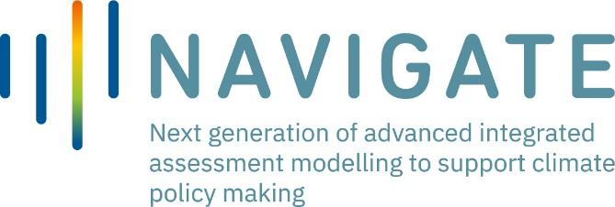
Incorporating social mechanisms in energy decarbonisation modelling
B. Verrier, P. H Li, S. Pye and N. Strachan, Environmental Innovations and Societal Transitions, 2022

Slide 2
Research objectives and methods
How to open the “black box” of lifestyle changes in UK energy futures, and model social mechanisms that have the potential to impede or foster rapid transitions?
System dynamics principles (non-linearity, feedback loops) are used to incorporate quantified UK attitudes (REEEM, 2018) into a probabilistic, behavioural energy system model (BLUE)

Slide 3
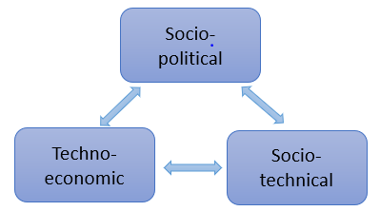
Contributions
Steps to model socio-technical insights, with a focus on the UK residential heating sector
A comprehensive review of the socio-technical energy transition (STET) literature
Illustrative scenarios to ponder the effect of non-monetary drivers on transitions
Exploration of uncertainty : climate risks perceptions, government actions, pace of social diffusion
High-level model structure (adapted from the Three Perspectives framework, Cherp, 2018)

Slide 4
Results
The societal diffusion of environmental values and resistance to change are core levers and barriers of technological transformations that can be channeled to fasten transitions
Model extension: dynamic technology preferences and diffusion of “green” values

Slide 5
Leveraging options: combined actions towards greater social motivation to act; government incentives for technology scale up; and ensuring rapid diffusion even in the more constrained segments of society
Scenarios results: faster vs constrained pace of social diffusion

