Slide 1
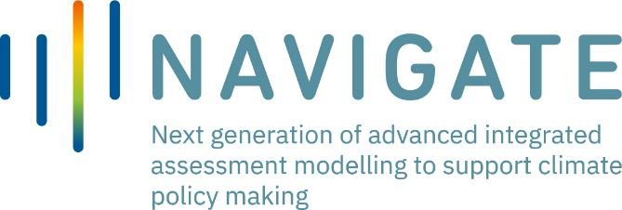
NAVIGATE Task 2.3 Socio-technical energy transition modelling - the TEMPEST model
Rachel Freeman, Steve Pye
Freeman, R. and Pye, S. (2022) ‘Socio-technical modelling of UK energy transition under three global SSPs, with implications for IAM scenarios’, Environmental Research Letters, 17(124022). doi:10.1088/1748-9326/aca54f.

Slide 2
Overview
A socio-technical energy transition simulation model, TEMPEST, incorporates societal and political factors influencing transition
Societal preferences for different mitigation measures
The importance of political capital as a “fuel” for energy transition
SSP1, SSP2 and SSP5 are interpreted for TEMPEST and modelling results compared to those from IMAGE for the same SSPs
Three recommendations for using TEMPEST results to improve understanding of the real-world feasibility of modelled IAM pathways

Slide 3
Model structure
TEMPEST’s simulation behaviours are endogenously generated from a system of interconnected feedback loops
Political capital is used to create policy ambition
Policy ambition increases the public willingness to participate in adopting mitigation measures

Slide 4
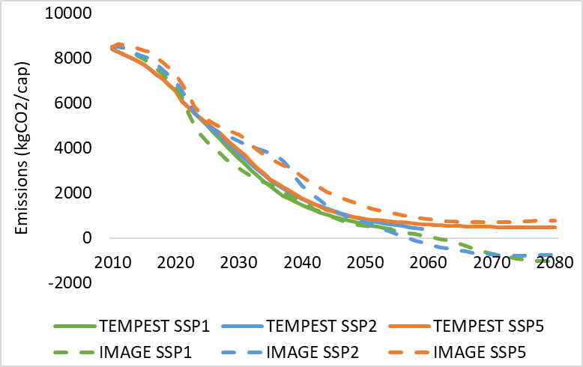
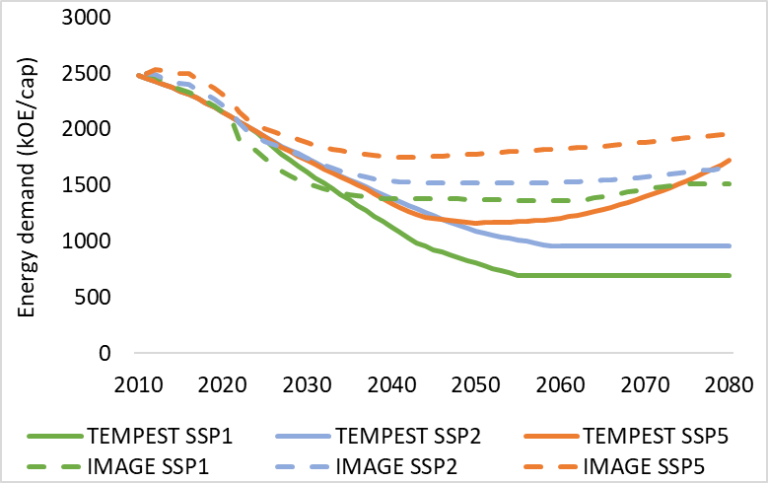
Comparing trends from TEMPEST and IMAGE
Rates of change in key indicators, in both models, are much lower in historic trends than in future – indicating how challenging and disruptive future changes are likely to be
IMAGE generally achieves higher emissions reductions (including BECCS that is not in TEMPEST)
TEMPEST pathways have higher energy demand reductions; ‘the power of demand-side changes might be underexplored in existing IAMs scenarios’ (Brutschin et al., 2021).

Slide 5
Recommendations
Need | Recommendation
IAMs do not include uncertainty about the achievability of societal targets, and the importance of political and societal support (Keppo et al., 2021). | Use TEMPEST results to set ranges of uncertainty in deployment of mitigation measures, which are driven by variability in political and societal factors.
There is risk of climate mitigation targets not being met due to societal pushback (climate policy backlash (Patterson, 2023)) during times of rapid and disruptive change in energy systems. | TEMPEST modelling shows a risk of up to 70% increase in emissions from strong pushback; TEMPEST findings could be used to assess IAM pathways for the magnitude of risk from pushback.
Energy service demand (ESD) in IAMs is exogenously driven, with inputs derived from decomposition analysis. Yet ESD in future is expected to be influenced by social innovation in energy service provision and other wider societal changes due to energy transition. | TEMPEST endogenously calculates ESD, allowing for testing of policy measures to influence ESD. TEMPEST results could be used to adjust IAM assumptions about “avoid, shift improve” behaviours to reflect a wider range of future societal responses and policy instruments.

