Slide 1
DELIVERABLE 1 Review of the Literature on Lifestyles

Slide 2
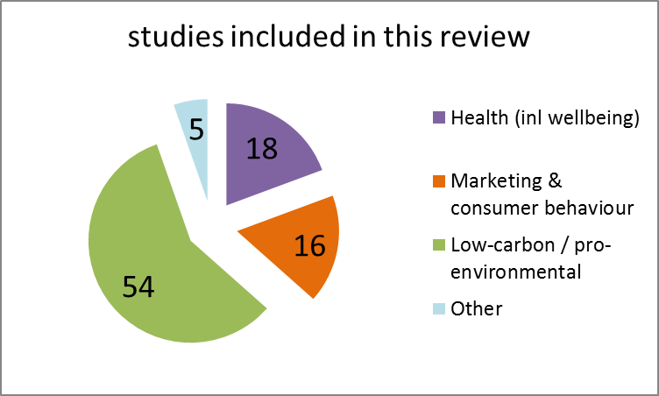
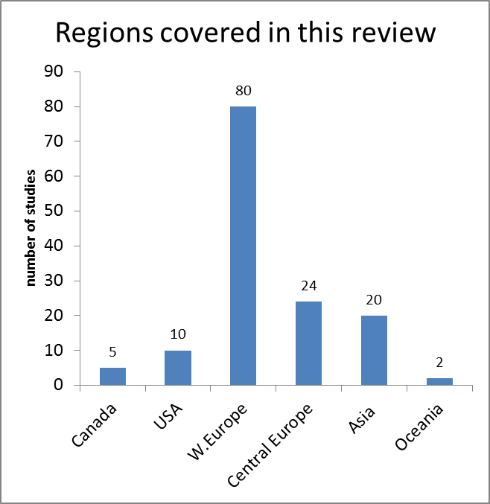
We conducted a large scale review of the literature on lifestyles to gain insights for low-carbon research
large scale (directed) review
range studies conceptual studies, empirical studies
across key domains health and wellbeing, marketing and consumer behaviour, low carbon / pro-environmental
global reach
Figure 1(a) – Studies by type
Figure 1(b) – Studies by region
Notes:
Our findings are based on a large scale review in which we read and annotated over 90 studies. These included conceptual and empirical work and key domains (with an emphasis on low carbon).
We identified key insights for low carbon lifestyle research :
Perspectives on low carbon lifestyles need to account for a wider range of cognitions.
Perspectives need to account for broad societal factors which shape and constrain lifestyles alongside intentions and other cognitions.
There is the opportunity to draw on a wide range of data including behavioural, psychological, contextual, sociodemographic, and clinical indicators (health) or variables.
Low-carbon lifestyle interventions would work better if they are more narrowly targeted. Public health and marketing interventions target specific lifestyle-related characteristics with specific interventions. These change relevant cognitions or contextual factors, and the behavioural outcomes desired.
We use these insights to develop a conceptual model for further empirical application

Slide 3
Deliverable 2 (1) Development of Conceptual Framework and Empirical Application to Four Countries

Slide 4
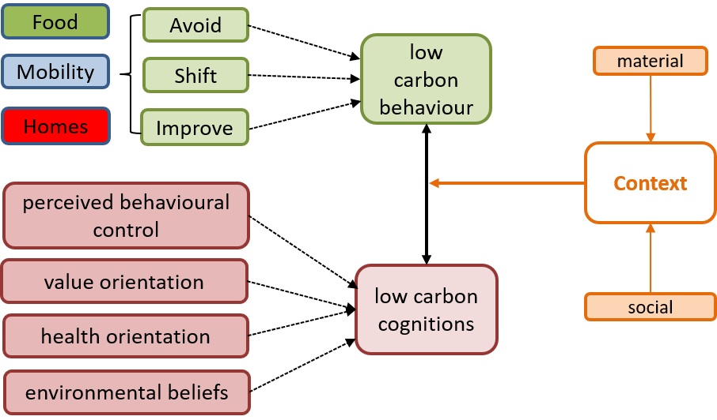
Figure 2 - Analytical Framework for Low-carbon Lifestyle
We define lifestyle as ‘the interplay between cognitions and behaviour in specific material and social contexts’
Notes:
Our conceptual framework builds on the substantive literature review. It frames low-carbon lifestyle as the interplay between cognitions and behaviour in specific material and social contexts. Low-carbon lifestyle consists of three key elements; low carbon behaviour, low carbon cognitions and context. Low carbon cognitions direct low carbon behaviour, but this relationship is recursive. Context is exogenous, it can be social or material. Low carbon cognitions consists of four distinctive but complimentary pathways to low carbon behaviour. Low carbon behaviour is measured in three domains and within each domain three types of behaviour (A-S-I framework).

Slide 5
We measure low-carbon lifestyle using large scale social survey data
Lifestyle type
Share of Sample
hierarchical cluster analysis
Resourceful
Large scale social survey data (UK, China, USA, Australia) N=15,900 2010 - 2018
22%
identification
The LIFE model
Active
30%
Constrained
27%
Cautious
21%
Share of population
National Geographic Greendex Survey (2009 and 2014)
World Values Survey (2010 – 2015)
World Bank (2018)
Global Competitiveness Index (2018)
Resourceful
25%
Active
36%
shaping parameters
extrapolation
Constrained
21%
The four lifestyle types are extrapolated to 18 countries
Cautious
18%
Figure 3 – Measuring and extrapolating low carbon lifestyles
Notes:
We apply this conceptual framework using rich empirical data from four separate data-sets in UK, China, USA and Australia to identify universal lifestyle types within and between these countries. All variables in our conceptual model are represented and measured. Behavioural variables cover all behaviour types across domains and the ASI framework. Each dataset is analysed separately to preserve within country heterogeneity. We use hierarchical cluster analysis to identify four universal lifestyle types (common across the four datasets). These are ‘Resourceful’, ‘Active’, ‘Constrained’ and ‘Cautious’.
Resourceful – Environmentally engaged
Active – healthy and goal driven
Constrained – contextually challenged
Cautious – the means but not the motivation
In a second phase of our empirical analysis we use ‘shaping’ parameters to extrapolate these lifestyle types across a wider geography. We draw on further datasets National Geographic ‘Greendex’ Survey (measures behaviour), World Values Survey (cognitions), World Bank/Global Comp index to identify ‘(context). From this data we identify the four lifestyle types globally (18 countries representing 10 model regions).

Slide 6
Deliverable 2 (2) Modelling Low-Carbon Lifestyle Change The LIFE Model
Notes:
We demonstrate the application of the LIFE model to global IAMs using MESSAGEix-Buildings.

Slide 7
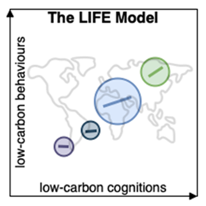
The LIFE Model: Summary
Strong empirical basis (national statistical surveys from 4 countries) (N=15,600)
Four types ‘Resourceful’, ‘Active’, ‘Constrained’, ‘Cautious’.
Characteristic (mean) scores on low-carbon behaviour and low-carbon cognitions
Within-cluster variation explained by contextual enablers or constraints which vary by type
Extrapolation functions ‘predict’ cluster size and characteristics for n countries
Position of each clusters on low-carbon behaviours is a function of A-S-I behaviours (data from National Geographic, Greendex Survey, 18 countries)
Position of each cluster on low-carbon cognitions is a function of perceived behavioural control, long-term value orientation, life satisfaction and environmental beliefs (data from World Values Survey, 100+ countries)
Figure 4 – The LIFE Model Schematic (1)
Notes:
Extrapolation functions predict cluster size and characteristics for other countries by matching these onto wider data sources. These include National Geographic, Greendex Survey (18 countries). World Values Survey (100+ countries), World Bank,

Slide 8
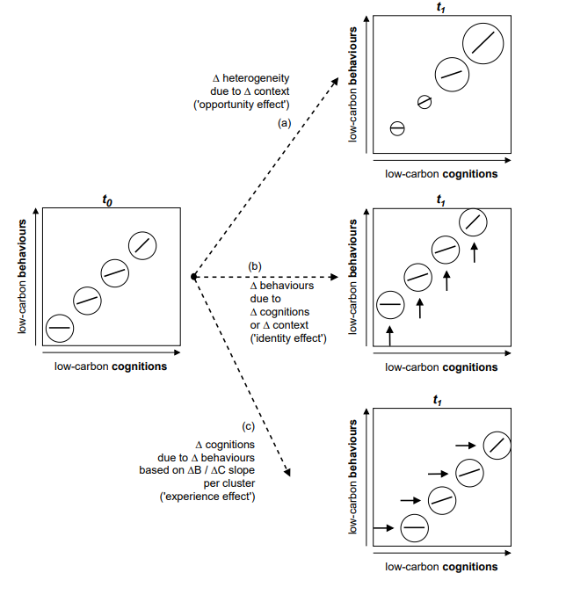
Drivers of Low-Carbon Lifestyle Change
Path (a) contextually-driven lifestyle - lifestyles shift as context becomes more enabling or constraining.
Path (b) cognitively-driven lifestyle - lifestyles reflect self-expression, personal ideology, and a sense of identity.
Path (c) behaviourally-driven lifestyle - lifestyles also shift in response to familiarity with behaviours (and technologies).
Figure 5 – The LIFE Model Schematic (2): Drivers of Low-Carbon Lifestyle Change.
Upper panel (a) shows the ‘opportunity effect’, driven by change in context.
Middle panel (b) shows the ‘identity effect’, driven by change in cognitions.
Notes:
There is a dynamic relationship between the three key elements of low-carbon lifestyle which explain lifestyle change. We use our empirical data to identify and measure three distinct mechanisms or drivers of lifestyle change over time.

Slide 9
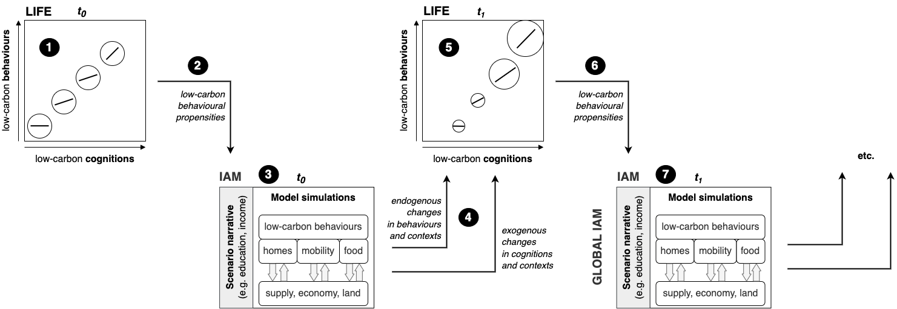
Coupling LIFE Model to a global IAM
Figure 6 – The LIFE Model Schematic (3): Generic Soft-Coupling with Global IAM
Notes:
This generic coupling approach is developed that iteratively exchanges information between the LIFE model and a global IAM.
Step 1. the LIFE model characterises four lifestyle types with distinct cluster sizes (% of population) and propensities towards low-carbon behaviours.
Step 2. The low-carbon behavioural propensities are applied to equations implicitly representing behavioural parameters or behavioural outcomes in the IAM.
Step 3. The IAM equations, modified by behavioural propensities from the LIFE model, generate behavioural outcomes (e.g., energy retrofit rates), as well as changes in context relevant to low-carbon behaviours (e.g., income growth).
Step 4/5. Changes in relevant IAM outputs are passed back to the LIFE model.
The LIFE model applies these to equations predicting cognitively and behaviourally-driven lifestyle change. The LIFE model uses the exogenous scenario narratives to predict contextually-driven lifestyle change
Step 6-7. The revised low-carbon behavioural propensities are fed back to the IAM, and then modified IAM equations re-estimate behavioural outcomes, in a repeat of Steps 2-3, and so on, through the timesteps of the full IAM simulation (e.g., to 2050, or to 2100).
These iterative feedbacks between the LIFE model and the global IAM translate the static characterisation of lifestyle heterogeneity and lifestyle change mechanisms in the LIFE model into a dynamic simulation of lifestyle change in the global IAM.

Slide 10
Test Implementation in a Single End-Use Sector Coupling LIFE and MESSAGEix-Buildings
Notes:
The simulation of low-carbon lifestyle change using a global IAM is demonstrated using a specific sectoral demand model. In its full implementation the LIFE model should be coupled to multiple demand sectors simultaneously.

Slide 11
Coupling LIFE and MESSAGEix-Buildings (proof of concept)
Iterative feedbacks between the LIFE and MESSAGE translate static characterisation of lifestyle heterogeneity and lifestyle change mechanisms in the LIFE model into a dynamic simulation of lifestyle change in MESSAGE.
1
- Lifestyle clusters size (11 regions)
- Behavioural propensity modifiers (global)
We run two scenarios
‘SSP2+LIFE’ introduces the LIFE model coupling to MESSAGEix-Buildings to evaluate the effect of endogenizing heterogeneous low-carbon lifestyles and distinct mechanisms of lifestyle change.
‘SSP2+LIFE+Values’ compares the effects of endogenizing low-carbon lifestyle and heterogeneous lifestyle change with and without an additional assumption of enhanced strong cognitively-driven lifestyle change (‘Identity’ effect).
LIFE Model
Four lifestyle types with distinct low-carbon cognitions and behaviour
MESSAGEix-Buildings
Modifiers affect
energy efficiency decisions
5
6
7
2
Iterative coupling
4
3
Changes in energy demand
(low carbon behaviour)
Exogenous forcing
Changes in external context
Scenario narrative
Figure 7 – Seven Step Coupling Approach (developed with MESSAGEix_Buildings)
Notes:
Step 1. The LIFE model generates four lifestyle types each with a size (% of total) and behavioural propensity modifiers
Step 2. The MESSAGEix-Buildings model uses the modifiers to amplify or reduce the intangible cost term in equations estimating efficiency improvements and reductions in set-point temperatures.
Step 3. The MESSAGEix-Buildings model reports change in total energy demand for space heating (EJ) at each time step as a proxy for aggregated behavioural change.
Step 4. Changes in final energy for space heating for each lifestyle type are passed back to the LIFE model.
Step 5. The LIFE model uses aggregated behavioural changes from MESSAGEix-Buildings to re-estimate input assumptions on low-carbon behaviours.
Step 6. The revised low-carbon behavioural propensities are fed back to the IAM.
Step 7. Modified IAM equations re-estimate behavioural outcomes. Return to step (1) for the next timestep. Note that both LIFE and MESSAGEix-Buildings run over a default five-year timestep, so are aligned over time periods of change in the empirical data (LIFE) and future simulations (MESSAGEix-Buildings).

Slide 12
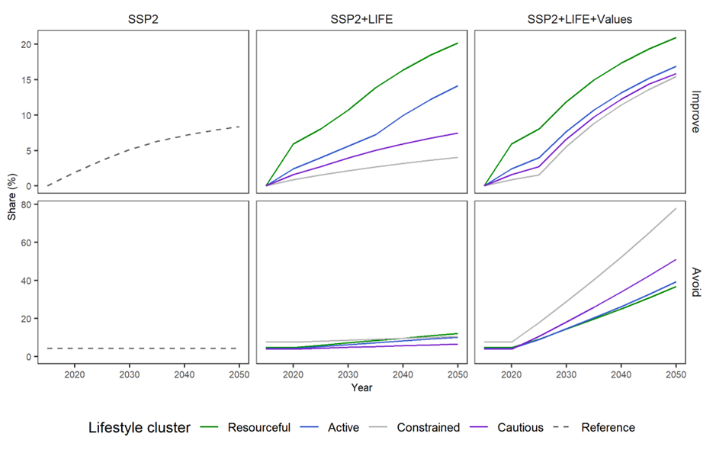
Key Finding 1: Drivers of lifestyle change distinguish between demand across energy-efficient behaviours
Figure 8(a) | Figure 8(b) ‘SSP2+LIFE’ | Figure 8(c) ‘SSP2+LIFE+Values’
Notes:
The relative influence of the drivers of lifestyle change, are noticeably different across the ‘Avoid’ dimension, reflecting differing levels of activity responsiveness across the lifestyle types. Under ‘SSP2+LIFE’ ‘Constrained’ and ‘Cautious’ types, characterised by lower incomes, are more highly responsive to energy saving ‘Avoid’ behaviours. In Figure 4(b) (bottom panel), we see no evidence of the activity gap between the engaged and disengaged types. Under ‘SSP2+LIFE+Values’ shares of ‘Avoid’ behaviour increase more rapidly and are higher in the disengaged types (Figure 4(c) (bottom panel).

Slide 13
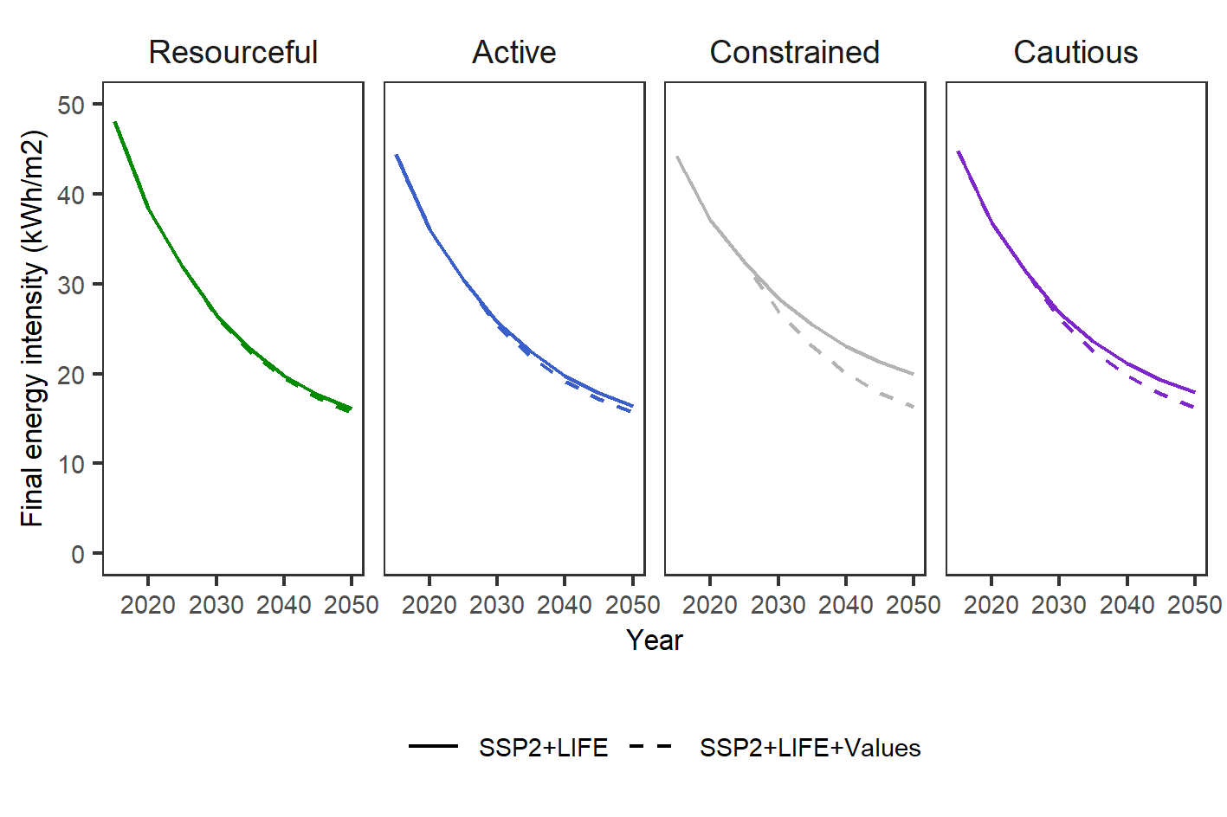
Key Finding 2: Simulated cognitive shifts under ‘SSP2+LIFE+Values’ reduces final energy intensity in the disengaged types.
Figure 9. Reduction in Final Energy Intensity for Space Heating by Lifestyle Type comparing ‘SSP2+LIFE’ with ‘SSP2+LIFE+Values’
Notes:
Under ‘SSP2+LIFE’ the introduction of lifestyle heterogeneity across ‘Avoid,’ and ‘Improve’ behaviours is reflected in differing energy intensities across groups (Figure 5). The enabled ‘Resourceful’ and ‘Active’ types, responsive to both ‘Avoid’ and ‘Improve’ activities, experience faster reductions in energy intensity between 2020 and 2050. Under ‘SSP2+LIFE+Values’ the sensitivity and flexibility of the coupling parameters to modelling strengthened drivers of low-carbon lifestyle change is confirmed. Our simulation of rapid change in intentions towards ‘Avoid’ and ‘Improve’ actions in the less responsive ‘Constrained’ and ‘Cautious’ types is reflected by accelerated reductions in final energy intensity, compared to ‘SSP2+LIFE’.

Slide 14
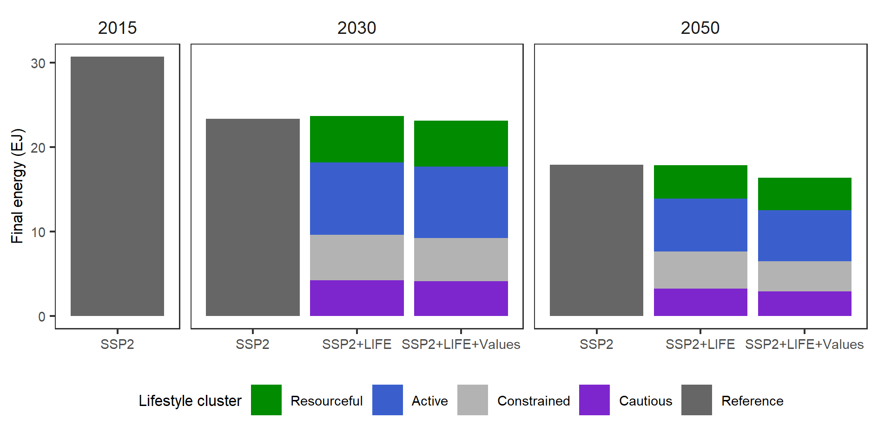
Key Finding 3: Drivers of lifestyle change also distinguish between demand in total energy.
Figure 10. Projections of Total Final Energy Demand for Space Heating by Lifestyle Type comparing Baseline (SSP2) with ‘SSP2+LIFE’ and ‘SSP2+LIFE+Values’, for the years 2015, 2030 and 2050.
Notes:
Combined energy intensities differentiated by group and cluster size result in differentiated reductions in total final energy demand for space heating (Figure 6). In ‘SSP2+LIFE’ we see only modest reductions compared to baseline SSP2 between 2030 and 2050. This reflects relative inactivity across ‘Avoid’ and ‘Improve’ dimensions in the ‘Constrained’ and ‘Cautious’ types. Under ‘SSP2+LIFE+Values’ increased activity across the disengaged types reduces final energy demand between 2030 and 2050 relative to baseline SSP2 and ‘SSP2+LIFE’.

Slide 15
Four Main Discussion points
We advance conceptual reasoning and methodological practice beyond the conventional approach to lifestyle change in global IAMs
The LIFE model has strong empirical foundations and uses robust methodological approaches for characterising lifestyle heterogeneity and estimating lifestyle change dynamics
Our approach specifically addresses criticisms of the framing and lack of representation of lifestyle heterogeneity and lifestyle change in global IAMs
The LIFE model is versatile and adaptable for soft-coupling with different IAM frameworks.

